Slide 1

EE 596 - Image and Video Coding
Mini Project
Designing an Image/Video Compression System
E/17/326
SEWWANDI E.A.T.

Slide 2
01
To investigate the basic functions of an image coding system.
02
To investigate the basic functions of a block-based video coding system.
Objectives
03
To investigate the Rate -Distortion optimisation techniques used in video coding.

Slide 3
Stage 1: Basic implementation: Image compression
(Intra Coding)
Forward Transform
Quantization
Entropy encoding
Source
image data
Compressed
image data
Store
or
transmit
Inverse transform
Reconstruction of quantized data
Entropy decoding
Reconstructed
image data
Compressed
image data

Slide 4

Methodology
Convert into grayscale image
Reconstructed image
Apply DCT
Apply Inverse DCT
Compression
Quantization
Dequantization
Decompression
Huffman encoding
Huffman decoding

Slide 5



Low quality
output
Medium quality
output
High quality
output
Results
Multiplication factor | 10 | 1 | 0.1
PSNR value | 27.3295 | 35.8081 | 43.8421

Slide 6
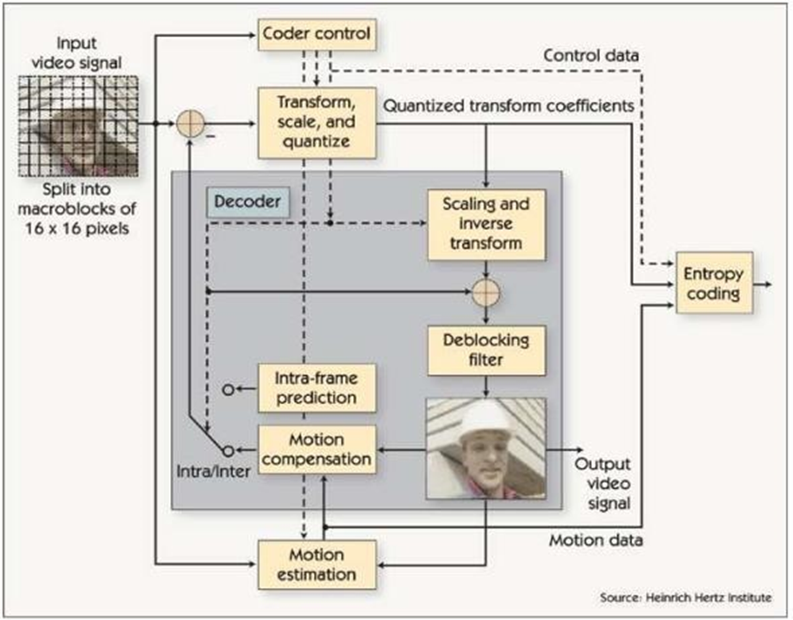
Stage 2: Basic implementation 2 : Video compression
(Intra Coding & Inter Coding)
Block diagram of H.264 hybrid video codec

Slide 7
Methodology
Compression
Use IPPPP…. Structure
Reference Frame(I Frame)
The first frame is compressed using the same method as in image compression without utilizing motion vectors.
P Frames
Find the Motion Vectors (Motion Estimation)
Block Matching Technique
Criteria used - Sum of Absolute Difference (SAD)
Search method - Sequential search
Construct the Predicted Frame (Motion Compensation)
Find the Residual
Residual = Current Frame – Predicted Frame
Apply DCT & Quantization to the Residual
Run Length Encoding

Slide 8
2. Decompression
Run Length Decoding
Apply Inverse DCT & Dequantization to obtain Decoded Residual
Construct Predicted Frame using Motion Vectors
Get the Reconstructed Current Frame
Decoded Residual + Predicted Frame = Reconstructed Current Frame

Slide 9



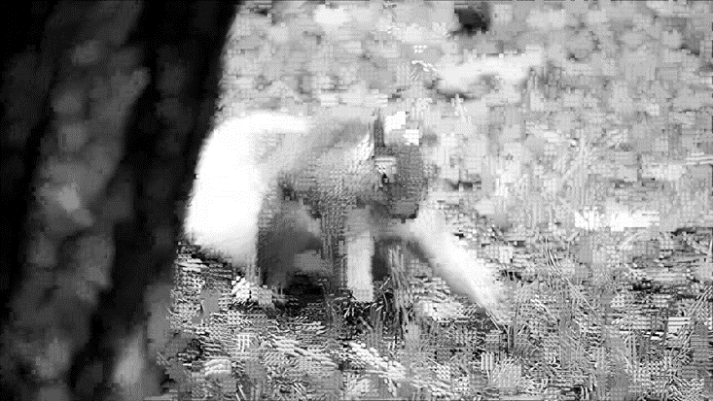
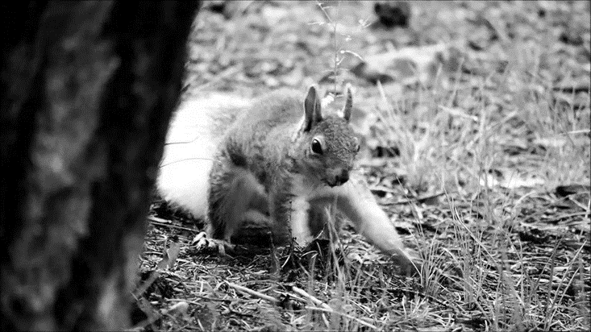
Results

Slide 10
Stage 3:
Improved Hybrid Video Codec

Slide 12
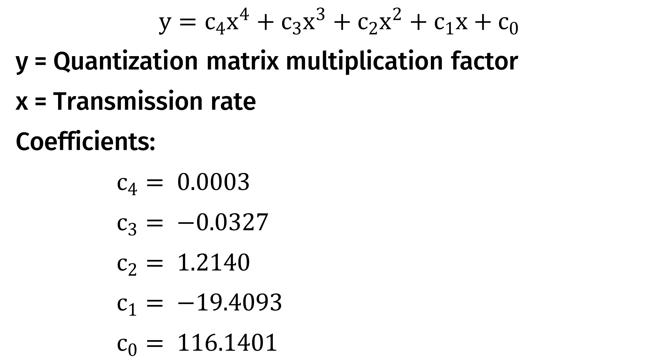
$$y=c_{4}x^{4}+c_{3}x^{3}+c_{2}x^{2}+c_{1}x+c_{0}$$
y = Quantization matrix multiplication factor
x = Transmission rate
Coefficients:
$c_{4}= 0.0003$
$c_{3}= −0.0327$
$c_{2}= 1.2140$
$c_{1}= −19.4093$
$c_{0}= 116.1401$

Slide 13
Thank You

